Slide 1
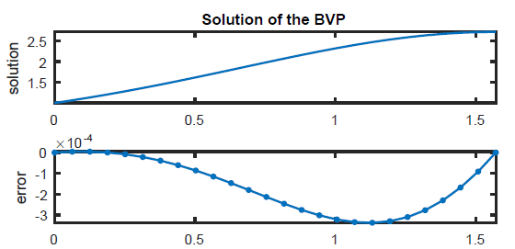
Chapter 10 Boundary-value Problems

Slide 2
The boundary-value problem
In Chapter 6, we saw ODE problems where all the boundary data was at one end of the domain, and solution is marched forward from that data: those are IVPs
We also encounter ODE problems where the boundary data is on both ends of the domain: those are boundary-value problems (BVPs)
For BVPs, the information is not one-way like IVPs, and this will have consequences

Slide 3
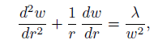
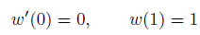
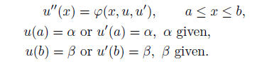
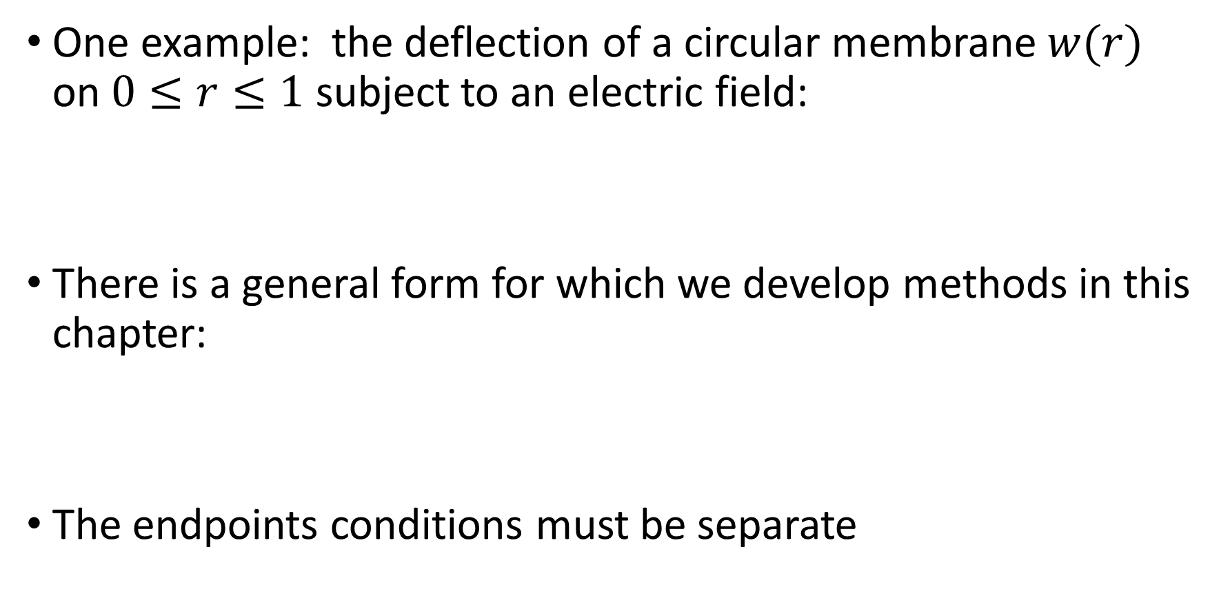
The boundary-value problem
One example: the deflection of a circular membrane $w(r)$ on $0≤r≤1$ subject to an electric field:
There is a general form for which we develop methods in this chapter:
The endpoints conditions must be separate

Slide 4
BVPs
The right hand side of the ODE can be nonlinear
If the rhs is of the form below, it is linear
Note that we assumed BCs that are linear
With BCs on both ends, we shall see different behavior that for IVPs

Slide 5
Section 10.1 Shooting

Slide 6
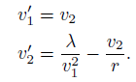
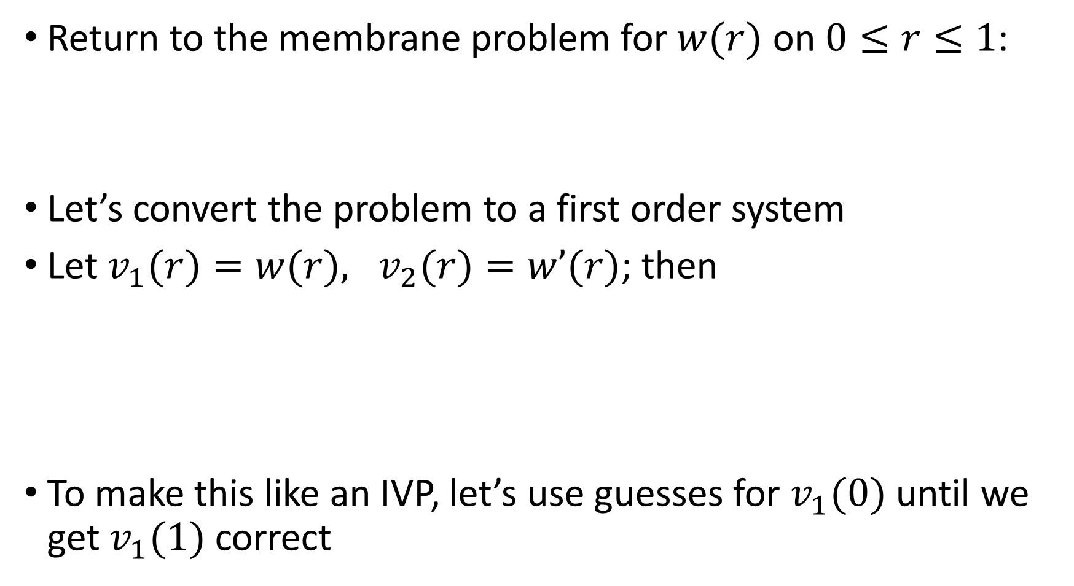
Shooting for BVPs
Return to the membrane problem for $w(r)$ on $0≤r≤1$:
Let’s convert the problem to a first order system
Let $v_{1}(r)=w(r), v_{2}(r)=w’(r)$; then
To make this like an IVP, let’s use guesses for $v_{1}(0)$ until we get $v_{1}(1)$ correct

Slide 7
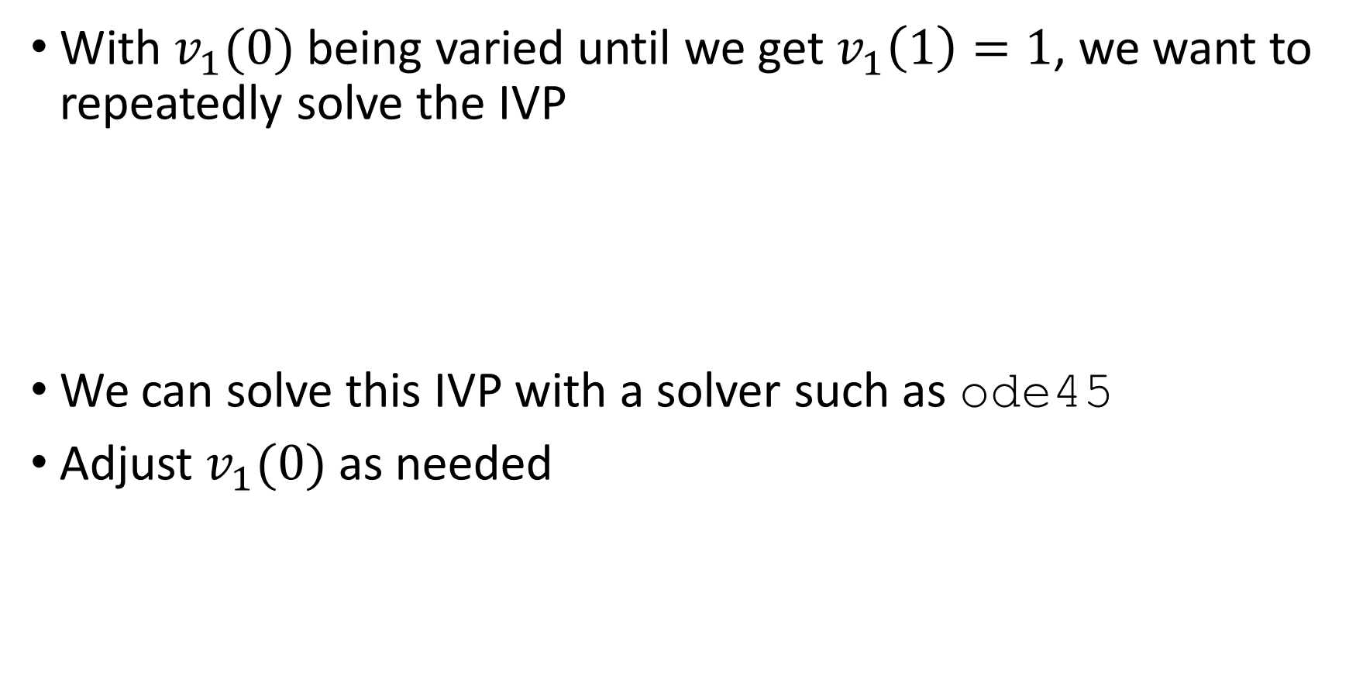
Shooting for BVPs
With $v_{1}(0)$ being varied until we get $v_{1}\left(1\right)=1$, we want to repeatedly solve the IVP
We can solve this IVP with a solver such as ode45
Adjust $v_{1}(0)$ as needed

Slide 8
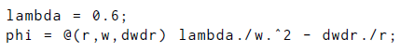
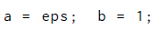
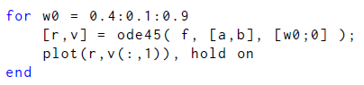
Example: Shooting
Explore the membrane BVP with $λ=0.6$
Define the ODE rhs for 2nd order version
Start the computation at a slightly positive value to avoid the origin
First order system version
Try a bunch of guesses and plot each curve

Slide 9
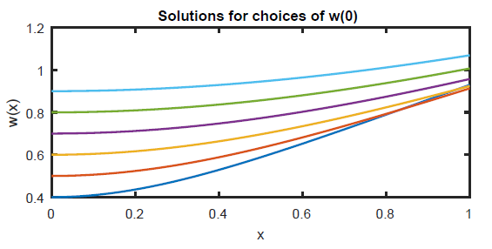
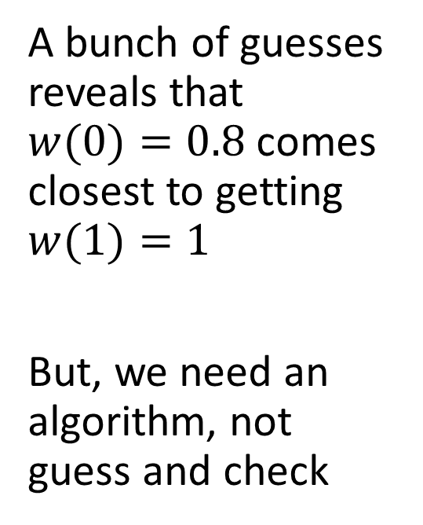
Example: Shooting
Explore the membrane BVP with $λ=0.6$
A bunch of guesses reveals that $w(0)=0.8$comes closest to getting $w(1)=1$
But, we need an algorithm, not guess and check

Slide 10
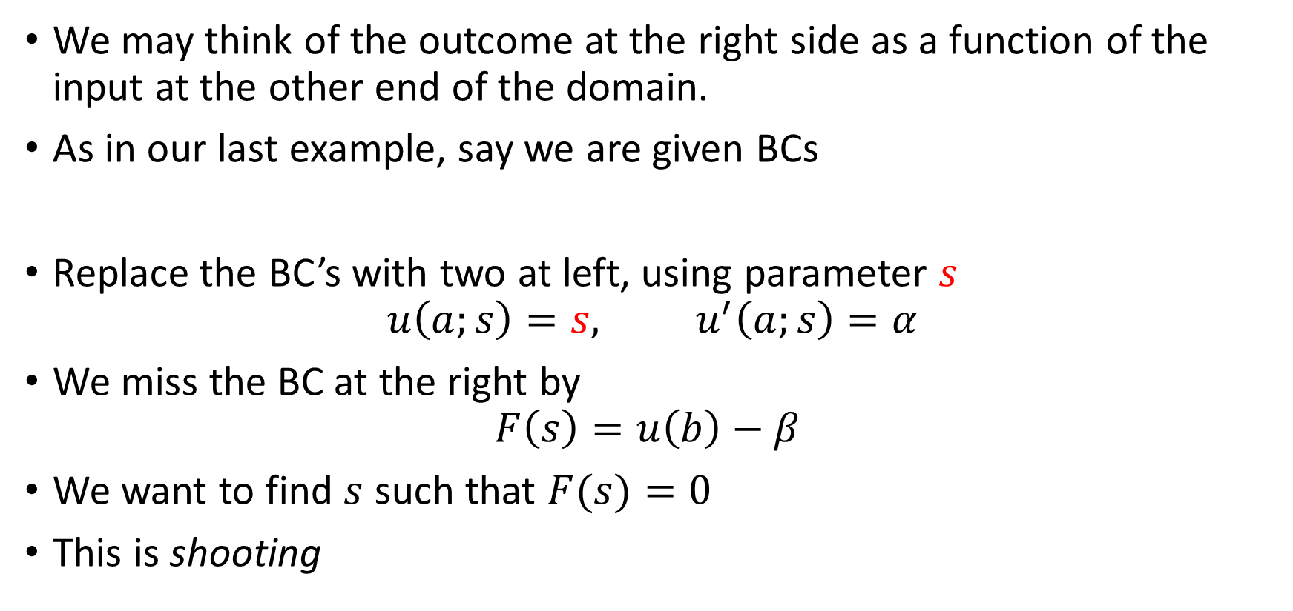
Shooting for BVPs
We may think of the outcome at the right side as a function of the input at the other end of the domain.
As in our last example, say we are given BCs
Replace the BC’s with two at left, using parameter $s$
$$u\left(a;s\right)=s, u^{′}\left(a;s\right)=α$$
We miss the BC at the right by
$$F\left(s\right)=u\left(b\right)−β$$
We want to find $s$ such that $F(s)=0$
This is shooting

Slide 11
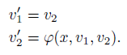
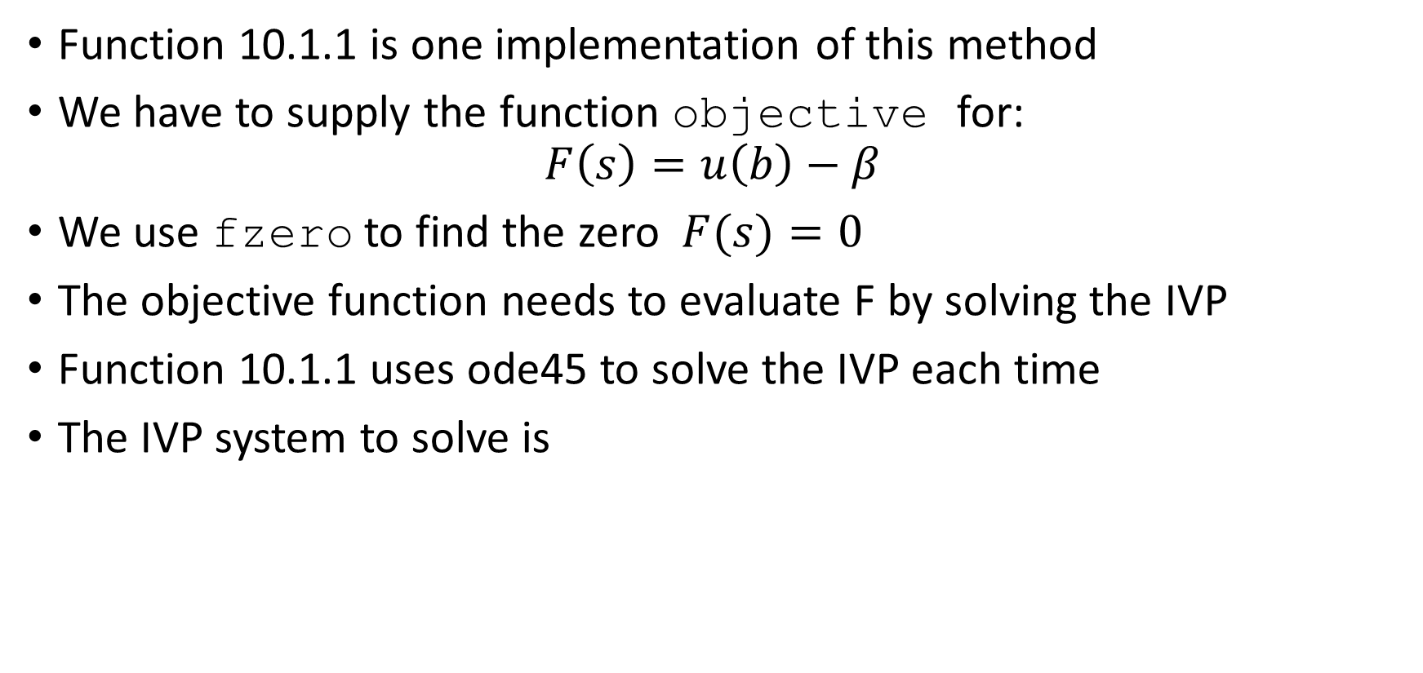
Shooting for BVPs
Function 10.1.1 is one implementation of this method
We have to supply the function objective for:
$$F\left(s\right)=u\left(b\right)−β$$
We use fzero to find the zero $F(s)=0$
The objective function needs to evaluate F by solving the IVP
Function 10.1.1 uses ode45 to solve the IVP each time
The IVP system to solve is

Slide 12
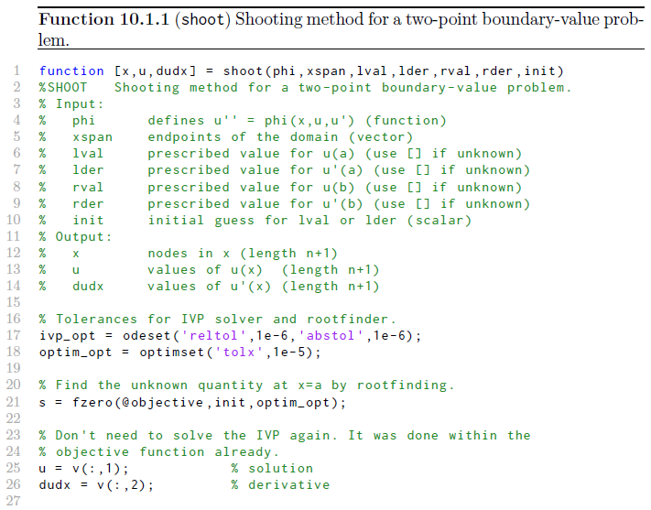
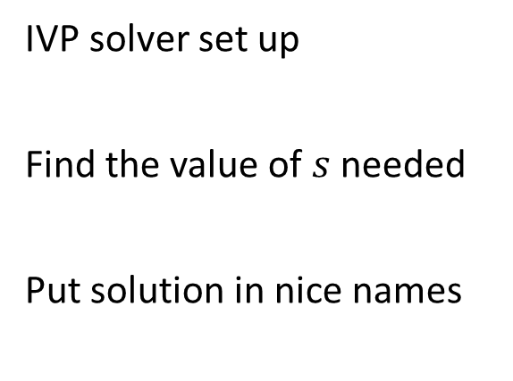
IVP solver set up
Find the value of $s$ needed
Put solution in nice names

Slide 13
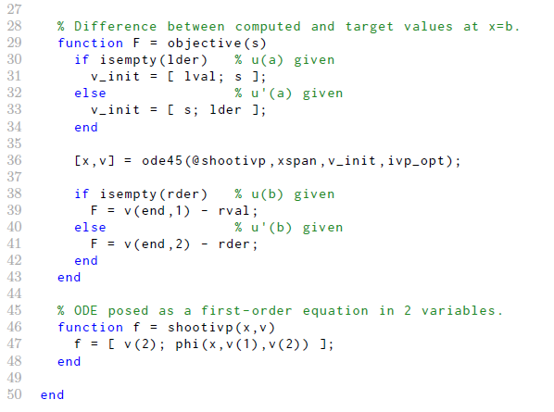
Set up initial guess value
Call solver for IVP
Evaluate objective for right end BC
First order system version: phi passed in

Slide 14

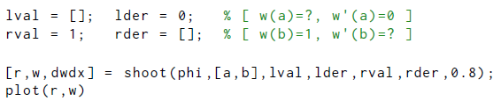
Example: Shooting
Membrane BVP again with $λ=0.6$ and shoot
Define the ODE rhs for 1st order system version
Start the computation at a slightly positive value to avoid the origin
Set up BCs so function knows which are used
No guessing now!

Slide 15

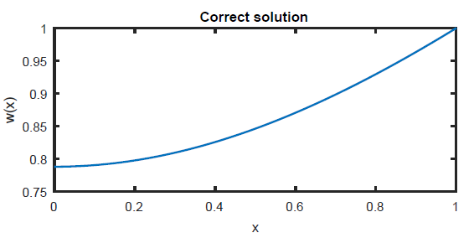
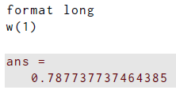

Example: Shooting
Membrane BVP with $λ=0.6$ and shoot
The correct value of $w\left(0\right)$ is:

Slide 16
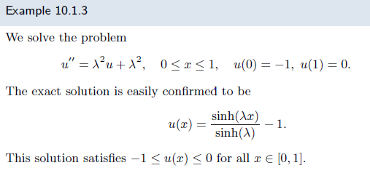
Instability of shooting
This is great, but this approach has problems in some cases: it can be unstable
Let’s illustrate this with an example

Slide 17

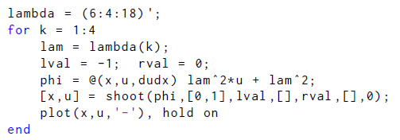
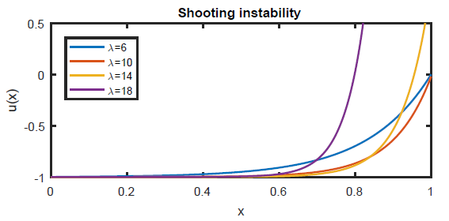
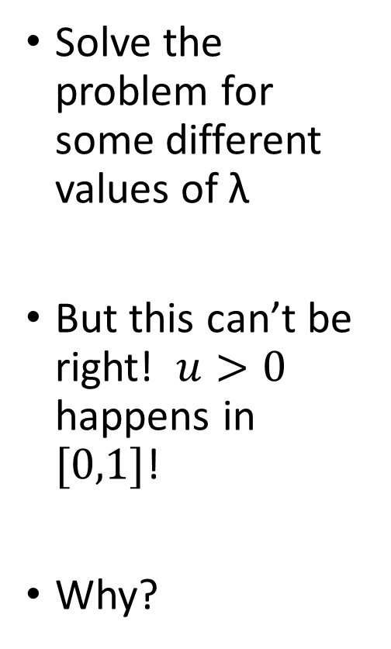
Example: Instability of shooting
Solve the problem for some different values of λ
But this can’t be right! $u>0$ happens in $[0,1]$!
Why?

Slide 18
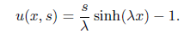
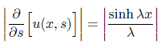
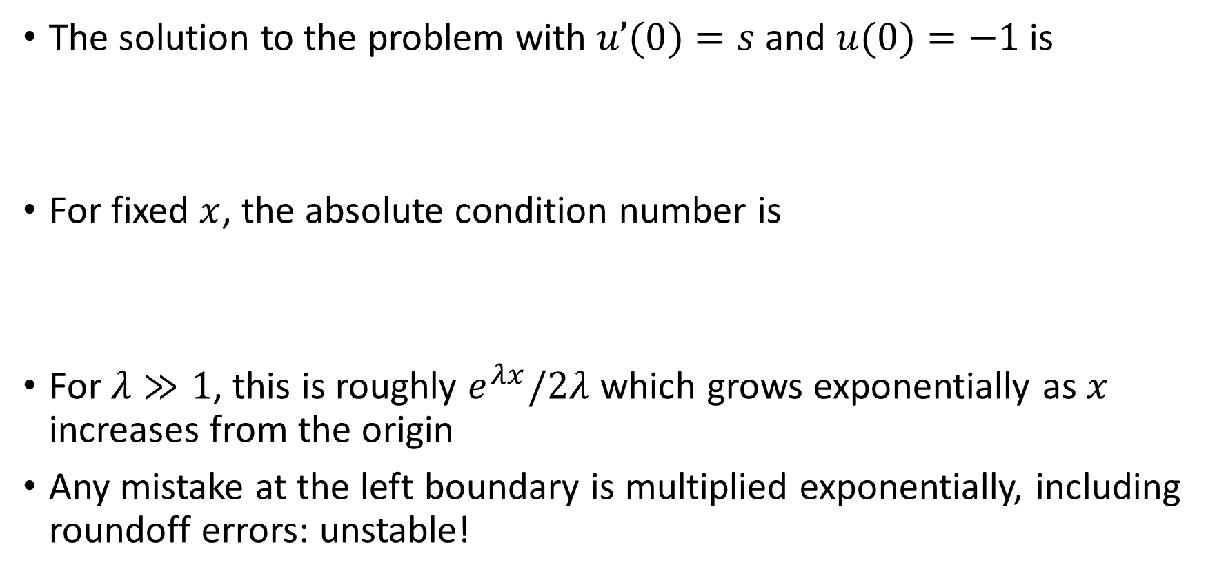
Example: Instability of shooting
The solution to the problem with $u’(0)=s$and $u(0)=−1$ is
For fixed $x$, the absolute condition number is
For $λ≫1$, this is roughly $e^{λx}/2λ$ which grows exponentially as $x$ increases from the origin
Any mistake at the left boundary is multiplied exponentially, including roundoff errors: unstable!

Slide 19
Shooting for BVPs
We could shoot for separate small intervals
We will develop a different method that converts the BVP to an algebraic system
Respects flow of information from both ends of domain
Solves for whole solution at once

Slide 20
Section 10.2 Differentiation matrices

Slide 21
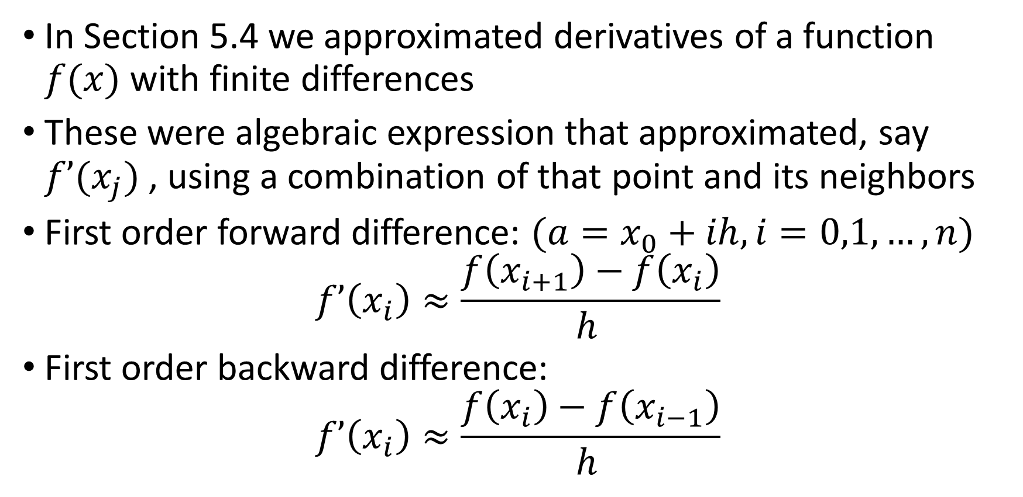
Differentiation matrices
In Section 5.4 we approximated derivatives of a function $f(x)$ with finite differences
These were algebraic expression that approximated, say $f’(x_{j})$, using a combination of that point and its neighbors
First order forward difference: $(a=x_{0}+ih, i=0,1,…,n)$
$$f’\left(x_{i}\right)≈\frac{f\left(x_{i+1}\right)−f\left(x_{i}\right)}{h }$$
First order backward difference:
$$f’\left(x_{i}\right)≈\frac{f\left(x_{i}\right)−f\left(x_{i−1}\right)}{h }$$

Slide 22
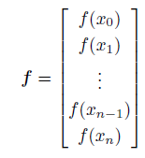
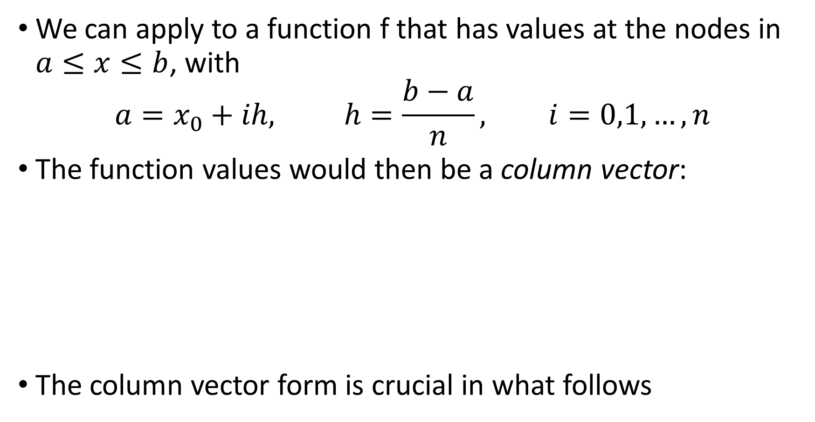
Differentiation matrices
We can apply to a function f that has values at the nodes in $a≤x≤b$, with
$$a=x_{0}+ih, h=\frac{b−a}{n}, i=0,1,…,n$$
The function values would then be a column vector:
The column vector form is crucial in what follows

Slide 23
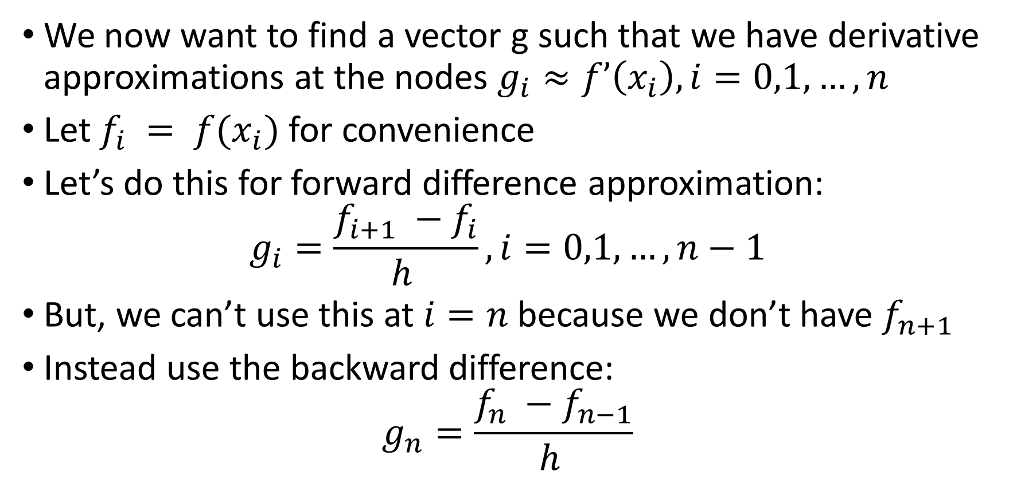
Differentiation matrices
We now want to find a vector g such that we have derivative approximations at the nodes $g_{i}≈f’\left(x_{i}\right),i=0,1,…,n$
Let $f_{i} = f(x_{i})$for convenience
Let’s do this for forward difference approximation:
$$g_{i}=\frac{f_{i+1} −f_{i}}{h }, i=0,1,…,n−1$$
But, we can’t use this at $i=n$ because we don’t have $f_{n+1}$
Instead use the backward difference:
$$g_{n}=\frac{f_{n} −f_{n−1}}{h }$$

Slide 24
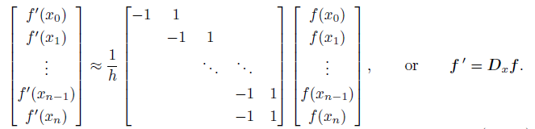
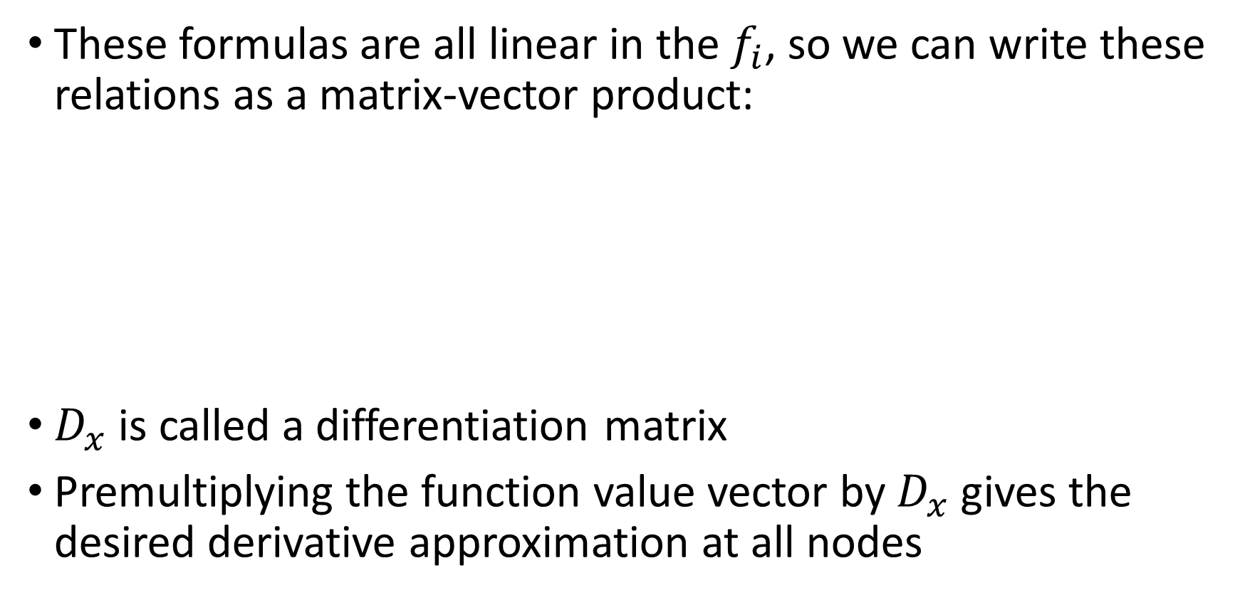
Differentiation matrices
These formulas are all linear in the $f_{i}$, so we can write these relations as a matrix-vector product:
$D_{x}$ is called a differentiation matrix
Premultiplying the function value vector by $D_{x}$ gives the desired derivative approximation at all nodes

Slide 25
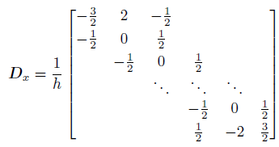
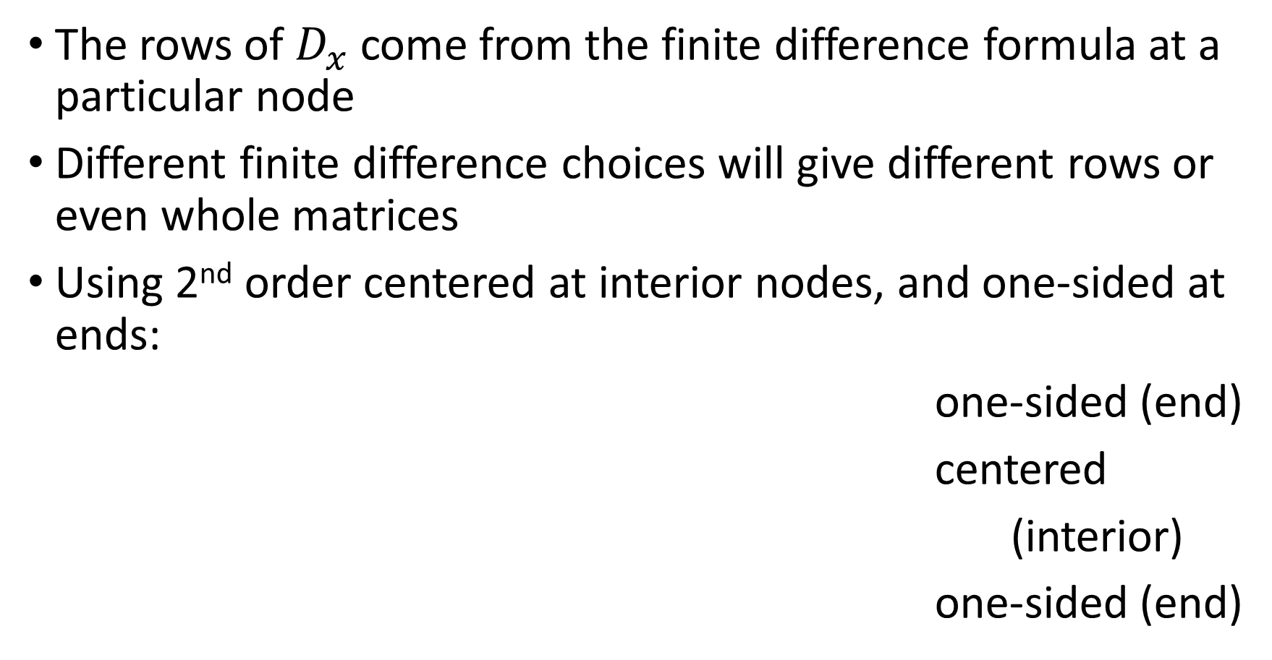
Differentiation matrices
The rows of $D_{x}$ come from the finite difference formula at a particular node
Different finite difference choices will give different rows or even whole matrices
Using 2nd order centered at interior nodes, and one-sided at ends:
one-sided (end)
centered
(interior)
one-sided (end)

Slide 26
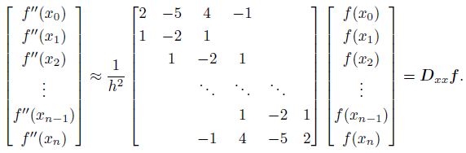
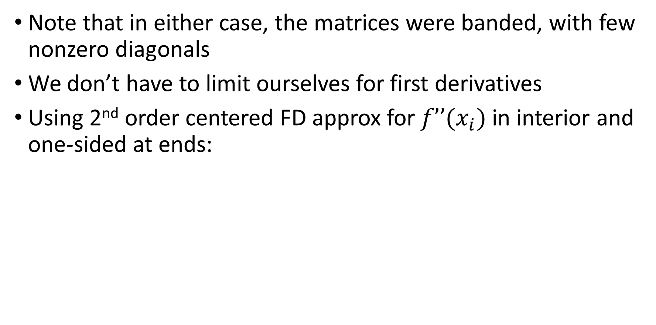
Differentiation matrices: finite difference (FD)
Note that in either case, the matrices were banded, with few nonzero diagonals
We don’t have to limit ourselves for first derivatives
Using 2nd order centered FD approx for $f’’(x_{i})$in interior and one-sided at ends:

Slide 27
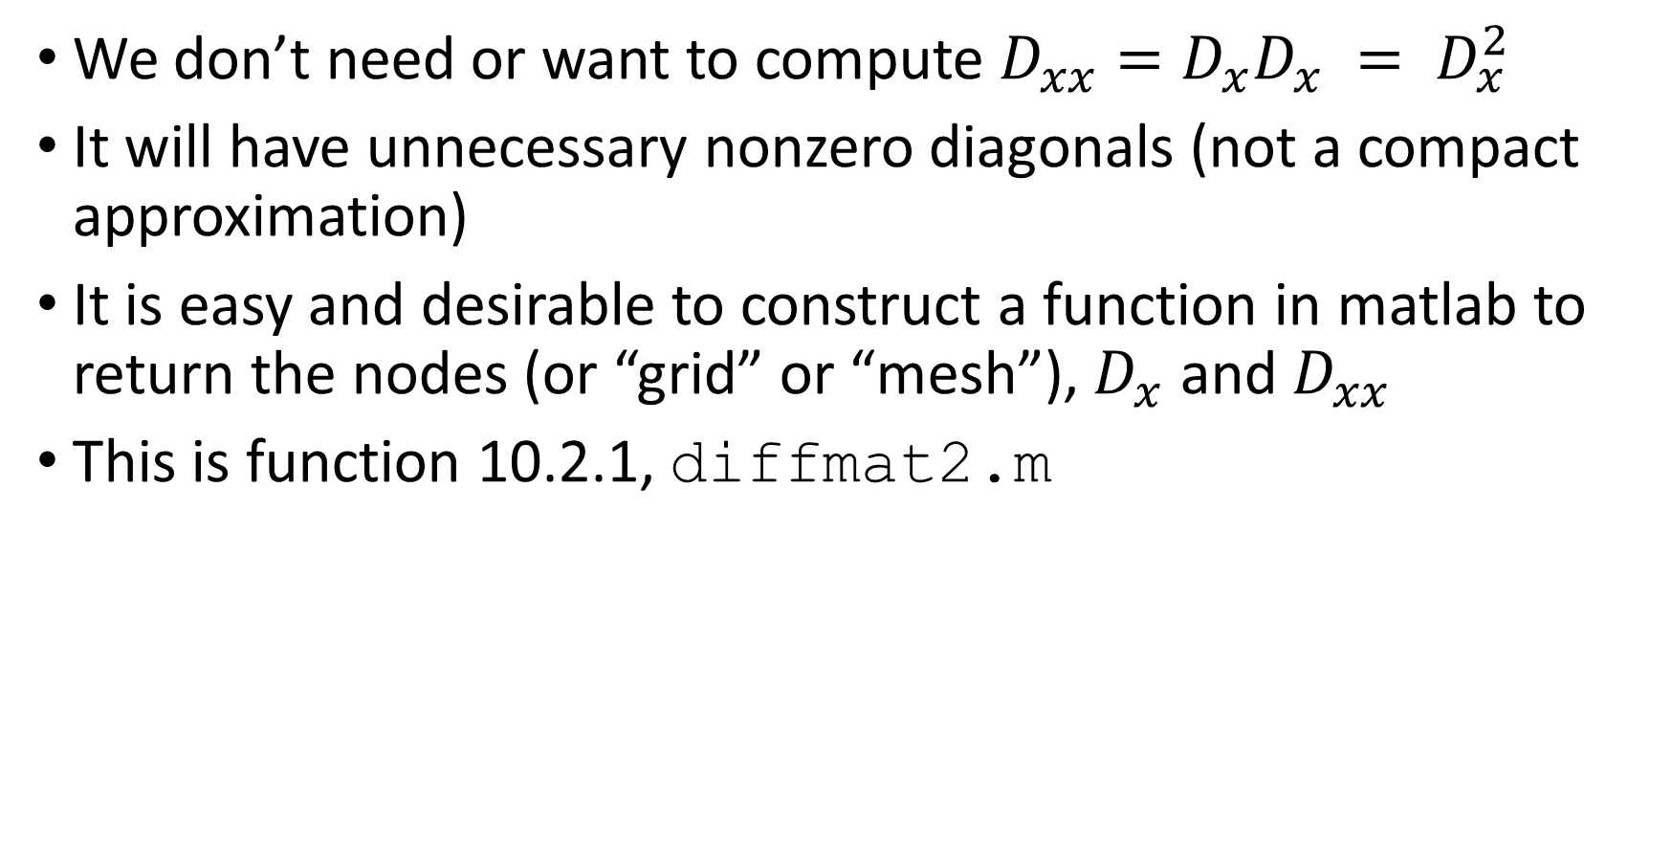
FD differentiation matrices
We don’t need or want to compute $D_{xx}=D_{x}D_{x} = D_{x}^{2}$
It will have unnecessary nonzero diagonals (not a compact approximation)
It is easy and desirable to construct a function in matlab to return the nodes (or “grid” or “mesh”), $D_{x}$ and $D_{xx}$
This is function 10.2.1, diffmat2.m

Slide 28
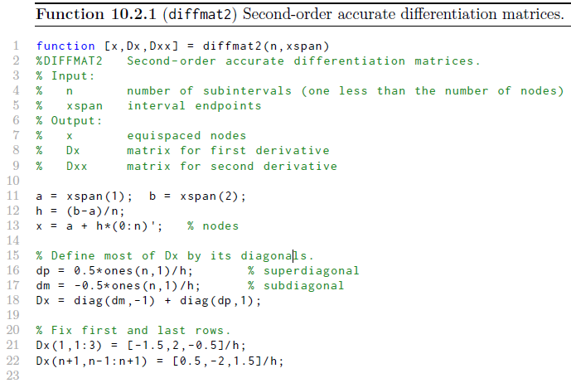

Slide 29
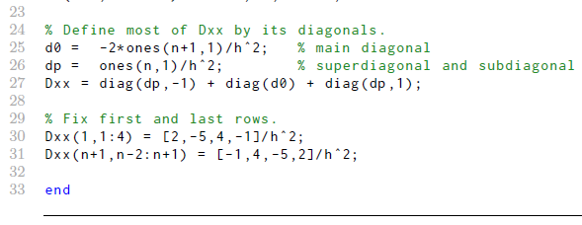
We can now use these matrices to differentiate a function at a set of nodes (the grid or mesh)
Let’s see an example

Slide 30

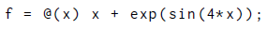
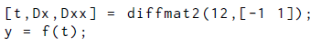
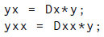
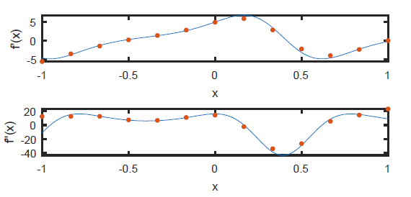
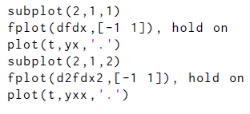
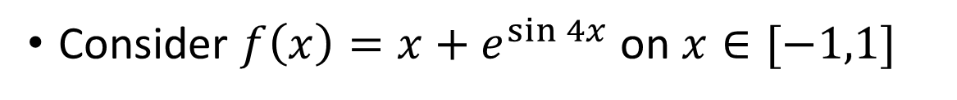
Example: differentiation matrices
Consider $f\left(x\right)=x+e^{\sin{4x}}$ on $x∈[−1,1]$

Slide 31
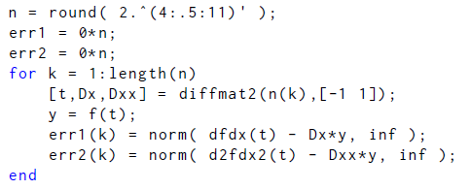
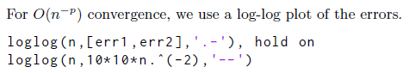
Example: differentiation matrices
Order of accuracy?

Slide 32


Example: differentiation matrices
Order of accuracy?
Compares well with model sequence of $O(h^{2})$ or $O(n^{−2})$

Slide 33


Spectral differentiation matrices
We have used finite difference formulas to build $D_{xx}, D_{x}$
To derive those, there is a three step process:
This process gave us a row in the matrix
A desirable approach is to use $n+1$ 2nd kind Chebyshev points and the corresponding polynomial $T_{n}(x)$

Slide 34



Spectral differentiation matrices
This time we use all of the $n+1$ 2nd kind nodes
Interpolate the $f$ vector with $T_{n}(x)$
Compute $T_{n}′(x_{i})$ to get the $i$-th row
The result is the Chebyshev differentiation matrix:

Slide 35

Spectral differentiation matrices
Note that the matrix $D_{x}$ is now full, not banded
This means computing $D_{xx}$ can be easy, We have used finite difference formulas to build: $D_{xx}=D_{x}^{2}$
There is also a dedicated formula for $D_{xx}$
Function 10.2.2 returns the 2nd kind points, $D_{x}$ and $D_{xx}$
The interval is $[a,b]$via a change of variables
The diagonals are also done differently

Slide 36



Slide 37


Example: spectral differentiation matrices
Example from degree 3 interpolant (4 nodes) here
Order of accuracy?
Need to compute a sequence of approximations…

Slide 38



Example: spectral differentiation matrices
Same $f(x)$ as previous example
Increase number of nodes by 5 each time

Slide 39


Example: spectral differentiation matrices
This is a log-linear (semilogy) plot
Exponential convergence as expected for a spectral method on an analytic function
Error for $f’’$is larger than for $f’$: typical
If $f$ not smooth enough, error is degraded
𝑛

Slide 40
Section 10.3 Collocation for linear problems

Slide 41

The collocation idea
We multiplied the known vector of function values by the matrix $D_{x}$ to get a derivative
But multiplying a vector of unknown values by $D_{x}$ is also a derivative
This can be done for individual terms in an ODE if the unknowns are at the same nodes or grid points
Collecting terms at each node gives an approximate equation for the unknowns there: This is enforcing the ODE (approximately) at the grid point
Collect all those equations and solve them: collocation!

Slide 42
The collocation idea: linear problems
Consider the linear problem:
Select nodes for the locations at which we will get approximate answers (grid or mesh)
Say the nodes are given by
For finite difference approximation, these are likely equispaced
For spectral differentiation, we would use 2nd kind Chebyshev points

Slide 43

The collocation idea: linear problems
We are going to solve for approximate solutions at the grid points denoted by
The hats indicate the exact solution
We will now set up the equations for the approximations at the nodes

Slide 44



The collocation idea: linear problems
The first derivative term at all grid points is, for a chosen $D_{x}$,
Similarly, for the second derivative,

Slide 45




The collocation idea: linear problems
Evaluate $r$
at nodes
Now put these into the ode problem:
Vector of unknowns
at nodes
Evaluate $q$
at nodes
Evaluate $p$
at nodes
We need to use some care in this conversion

Slide 46





Collocation for linear problems
The $p$ and $q$ become diagonal matrices, and $r$ is a vector
The discrete form is:
where

Slide 47

Collocation for linear problems
We can write the discrete version of the ODE in a short form:

Slide 48



The collocation idea: linear problems
Resulting equation was $n+1$ equations for $n+1$ unknowns
But we have not yet used the boundary conditions
Here’s one way to do it: replace the first and last rows with these equations
In matrix form, create
(it is $n−1 × n+1$)
Premultiplying an $n+1 × n+1$ will truncate the first and last row
We can now put the BCs in those rows…

Slide 49


The collocation idea: linear problems
Note that
Put these together with premultiplication by $E$ to get the linear algebra problem
Note that we don’t have to premultiply by $E$ in code: we can just replace those rows with indexing
Then just solve the system! u=A\b or similar

Slide 50


Slide 51



Example: collocation for linear bvp
Note that ODE is in standard form already
Don’t have to rewrite to use function 10.3.1
Define p,q,r and call bvplin
Then plot

Slide 52

Example: collocation for linear bvp
x

Slide 53





Example: accuracy of collocation for linear bvp
This BVP caused problems for shooting
Note that ODE is not in standard form
Need to rewrite a little to use function 10.3.1
Compute error and tabulate for several $n$

Slide 54



Example: accuracy of collocation for linear bvp
Doubling n reduces error by a factor of four
This is second order converge
Also called $O(h^{2})$ or $O(n^{−2})$

Slide 55


The collocation idea: linear problems
Let
We can then manipulate the linear algebra problem $Au=b$ as follows:
Here $τ(h)$ is the truncation error
It turns out that vanishes like $τ(h)$ if is bounded as $h→0$: this is stability, guaranteed for reasonable conditions
approx
answer
exact
answer
error
vector

Slide 56
Section 10.4 Nonlinearity and boundary conditions

Slide 57

Nonlinear BVPs
For linear problems, the ODE solution was changed from a function to a vector evaluated at the nodes (grid points)
We multiplied by the matrix $D_{x}$ or $D_{xx}$ to approximate derivatives
Any variable coefficients and forcing functions became matrices or vectors
Boundary conditions were put in first and last row
Linear algebraic system was solved
This process is collocation
What about nonlinear problems?

Slide 58
Nonlinear BVPs
For nonlinear problems, we approximate these the same way:
solution,
derivatives,
coefficients and forcing,
and boundary conditions
But any nonlinearities present cause the algebraic system to be nonlinear
We need to use quasi-Newton or similar methods to solve the resulting algebra problems

Slide 59


Collocation: nonlinear problems
Consider the nonlinear problem:
The function can be nonlinear in $u$ or $u’$ or both
Example: $φ\left(x,u,u^{′}\right)=xu[1−{\left(u^{′}\right)}^{2}]$
Example: $φ\left(x,u,u^{′}\right)=u−u^{3}−u^{′}$
Example: ${xu}^{′′}+2u^{′}+u−u^{3}=x$; rearrange to get standard form: $u^{′′}=φ\left(x,u,u^{′}\right)=(x−u+u^{3}−2u^{′})/x$
Conversion to algebra…

Slide 60



Collocation: nonlinear problems
Collocate at $x_{0},x_{1},…,x_{n}$ to get algebraic equations
Use differentiation matrices to get the vector equation
where
and the derivative approximations use the $i$th row of $D_{x}u$:
BCs replace first and last rows again

Slide 61

Collocation: nonlinear problems
BCs replace first and last row of discrete equations
We can use the E matrix again to theoretically remove the first and last row
Then simply put the BCs in those rows:
Nonlinearity comes from equations at interior points
Now need solution method for this system: Sections 4.5, 4.6
These rows are for all
interior points
Each row is a nonlinear
algebraic equation

Slide 62


Example: nonlinear bvp
Consider
We need to put it in standard form:
Let n=3, so that there are four grid points:
$$h=(b−a)/n=(3/2−0)/3=1/2$$
$$x_{0}=0, x_{1}=\frac{1}{2}, x_{2}=1, x_{3}=\frac{3}{2}$$
First, write the ODE at each node, then replace those at the blue nodes with BCs

Slide 63




Example: nonlinear bvp
First, derivatives at interior points:
Next, right hand side term:
Now put these two together with the BCs…
$sin⁡(xu)$ term
$e^{xu′}$ term

Slide 64

Example: nonlinear bvp
First, derivatives at interior points:
Putting together with BCs:
Now apply a quasi-Newton method or similar…

Slide 65


Boundary conditions
Boundary conditions for BVPs that are most common:
Dirichlet: specify $u$ at an end, e.g., $u(a)=α$
Neumann: specify $u′$ at an end, , e.g., $u′(a)=α$
Robin: specify linear combo of $u$ and $u′$ at an end
More generally, the BCs could be functions of $u$ and $u′$
But we need the discrete form:
ϒ

Slide 66

Boundary conditions
The discrete form is
The factor σ is used to scale the BCs to be the same size as the rows from the interior points
For a Dirichlet BC, use $σ=h^{−2}$
For a Neumann BC, use $σ=h^{−1}$
Still need algebraic solver. One option is levenberg from section 4.6
Let’s look at Matlab function bvp now
ϒ

Slide 67

Specify initial guess for solver
Specify BCs
setup

Slide 68

Algebraic solver
Interior point equations
Specify BCs

Slide 69
(Sections 4.5 and 4.6) Brief review of nonlinear algebraic problems

Slide 70

Root finding: Newton’s method
We seek $f\left(p\right)=0$ for $x=p$.
We want to use Taylor’s theorem to linearize the problem near $p$.
If we Taylor expand about x near p, we obtain
$$f\left(p\right)=f\left(x\right)+\frac{f^{′}\left(x\right)}{1!}\left(p−x\right)+\frac{f^{′′}\left(ξ(p)\right)}{2!}{\left(p−x\right)}^{2}$$
The number $ξ(p)$ makes the formula exact.
To solve the problem approximately, we neglect the quadratic term, which may be expected to work if $\left|p−x\right|≪1$

Slide 71

Root finding: Newton’s method
Also use $f\left(p\right)=0$ to obtain
$$0 ≈f\left(x\right)+\frac{f^{′}\left(x\right)}{1!}\left(p−x\right)$$
This is the equation for a line tangent at $x$, which crosses the $x$-axis near p, but not at it (if things work right)
Solving for p,
$$p≈x−\frac{f\left(x\right)}{f^{′}\left(x\right)}$$
Because we aren’t at the root, we turn this into an iteration:
$$x_{k+1}=x_{k}−\frac{f\left(x_{k}\right)}{f^{′}\left(x_{k}\right)}, k=0,1,…$$

Slide 72

Newton’s method for systems
We want to turn the previous approach into something for nonlinear systems.
We want to solve a system for the $x_{i}$ where
$$f_{1}(x_{1},x_{2}) = 0, f_{2}(x_{1},x_{2})=0$$
We need both $f_{i}$ to be zero at the same locations $x=p$, with
$$x=\left[\begin{matrix}x_{1} \\ x_{2}\end{matrix}\right], p=\left[\begin{matrix}p_{1} \\ p_{2}\end{matrix}\right]$$
Let
$$F=\left[\begin{matrix}f_{1}(x) \\ f_{2}(x)\end{matrix}\right]=\left[\begin{matrix}f_{1}(x_{1},x_{2}) \\ f_{2}(x_{1},x_{2})\end{matrix}\right]$$
At the roots we have
$$F=\left[\begin{matrix}f_{1}(p) \\ f_{2}(p)\end{matrix}\right]=\left[\begin{matrix}0 \\ 0\end{matrix}\right]=0$$

Slide 73

Newton’s method for systems
Linearizing about p gives $J(x^{(0)})$, the Jacobian matrix,
$$J(x^{(0)})=\left[\begin{matrix}f_{1,x_{1}}\left(x^{\left(0\right)}\right) & f_{1,x_{2}}\left(x^{\left(0\right)}\right) \\ f_{2,x_{1}}\left(x^{\left(0\right)}\right) & f_{2,x_{2}}\left(x^{\left(0\right)}\right)\end{matrix}\right]$$
The elements are the partial derivatives of the $f_{i}$ with respect to $x_{i}$ and evaluated at $x^{\left(0\right)}$
This linearized system only approximates $p$
$$0 ≈F\left(x^{(0)}\right)+J(x^{(0)})(p\text{−}x^{\left(0\right)}\text{)}$$
Solving gives
$$p\text{≈}x^{\left(0\right)}+J^{−1}(x^{(0)})F\left(x^{(0)}\right)$$
Analogous with scalar version
$$p≈x−\frac{f\left(x\right)}{f^{′}\left(x\right)}$$

Slide 74

Newton’s method for systems
The theoretical iteration is below; we don’t compute with this:
$$x^{\left(k+1\right)}\text{=}x^{\left(k\right)}+J^{−1}(x^{(k)})F\left(x^{(k)}\right),k=0,1,…$$
We instead solve the linear system and then update the iterate.
Define
$$x^{\left(k+1\right)}\text{=}x^{\left(k\right)}+{Δx}^{\left(k\right)}$$
Then, rewrite the top equation as
$$J\left(x^{\left(k\right)}\right)\left(x^{\left(k+1\right)}\text{−}x^{\left(k\right)}\right)=−F\left(x^{(k)}\right)$$
Or,
$$J\left(x^{\left(k\right)}\right)\left({Δx}^{\left(k\right)}\right)=−F\left(x^{(k)}\right)$$
This system is solved each iteration, then compute the updated iterate from $x^{\left(k+1\right)}\text{=}x^{\left(k\right)}+{Δx}^{\left(k\right)}$

Slide 75

Newton’s method for systems
So, the approach is as follows:
Write the equations as $f_{i}(x_{1},…x_{n})=0, i=1,2, …,n$.
Create
$$F\left(x_{k}\right)=\left[\begin{matrix}f_{1}(x_{k}) \\ ⋮ \\ f_{n}(x_{k})\end{matrix}\right]$$
Solve the system
$$J\left(x_{k}\right)\left(Δx_{k}\right)=−F\left(x_{k}\right)$$
Then compute the updated iterate from
$$x_{k+1}\text{=}x_{k}+Δx_{k}$$
Repeat until $\left\|{Δx}_{k+1}\right\|$ and $\left\|F\left(x_{k+1}\right)\right\|$ are small enough

Slide 76

Nonlinear least squares fits
For convenience think of the problem as finding the parameters $x∈ℝ^{n}$ in the vector function $f(x)∈ℝ^{m}$ so that we minimize the residual:
We can also think of this as minimizing $f^{T}(x)f(x)$
To solve the problem, we proceed by linearization again
Define the linearization about $x_{k}$ as
$$q\left(x\right)=f\left(x_{k}\right)+J\left(x_{k}\right)(x−x_{k})$$
For convenience, define
$$h_{k}=x−x_{k}, f_{k}=f\left(x_{k}\right), J_{k}=J\left(x_{k}\right)$$

Slide 77

Nonlinear least squares fits – Gauss-Newton
So, here is our recipe:
Begin with initial guess
Evaluate $f_{k}$ and $J_{k}$
Solve $J_{k}h=−f_{k}$ for $h$, $k=1,2,…$
Each time we update via $x_{k+1} =x_{k}+h$
Repeat previous three steps until $h$ is small enough
How to solve the linear least squares problem for $h$?
Called “Gauss-Newton” iteration; can use newtonsys.m

Slide 78

Quasi-Newton: Levenberg’s method
It may be advantageous to adjust the linear solves and update direction
This was the Newton’s method equation for the update:
$$\tilde{J}(x_{k})\left(Δx_{k}\right)=−F\left(x_{k}\right)$$
A different way to decrease ${\left\|f(x)\right\|}_{2}$ is to use steepest descent
In this approach , consider $r={(\left\|f\left(x\right)\right\|}_{2})2=f^{T}f$
Recall that from calculus, that the negative of the gradient is the direction of steepest descent of a function
Then, $∇r\left(x\right)=∇\left(f^{T}\left(x\right)f\left(x\right)\right)=2J^{T}\left(x\right)f\left(x\right)$
We could try to figure out a step from $v(x)= −sJ^{T}\left(x\right)f\left(x\right)$ where $s$ is a scalar that must be found (like $t$ in line search)

Slide 79

Quasi-Newton: Levenberg’s method
The steepest descent method can slow down depending on the direction’s relation to the minimum
Newton’s method may be difficult to start but converges quickly near the answer
Get the best of both by combining them: Levenberg’s method
In this method, one solves:
$$\left(J^{T}J+λI\right)v=−J^{T}f$$
For $λ=0$, we get back to Newton’s method
For $λ→∞$, we get close to steepest descent
We implement a method that varies $λ$ so that it starts large and gets reduced as needed in levenberg.m

Slide 80
Back to Section 10.4 Nonlinearity and boundary conditions

Slide 81





Example: nonlinear pendulum
Consider
$$θ^{′′}+\frac{1}{20}θ^{′}+\sin{θ}=0, θ\left(0\right)=\frac{5}{2}, θ\left(5\right)=−2$$
We need to put it in standard form:
$$φ\left(x,u,u^{′}\right)=−\frac{1}{20}θ^{′}−\sin{θ}$$
Setup and call bvp.m
Indepdent variable
$$θ′$$
$$θ$$

Slide 82

Example: nonlinear pendulum

Slide 83



Example: nonlinear pendulum
Now try new end time ($0≤t≤8$)
$$θ^{′′}+\frac{1}{20}θ^{′}+\sin{θ}=0, θ\left(0\right)=\frac{5}{2}, θ\left(8\right)=−2$$

Slide 84




Example: nonlinear membrane
Let’s return to membrane problem on $0≤r≤1$
We shall see that different initial guesses give different answers: there may be multiple solutions at the same parameter values
All are 1
All are 1/2

Slide 85


Example: nonlinear membrane
Membrane problem on $0≤r≤1$ with $λ=0.5$
Initial guess 1
Initial guess 1/2

Slide 86


Example: Cahn-Allen equation
Consider
$$εu^{′′}+u−u^{3}=0, u′\left(0\right)=0, u\left(1\right)=1$$
Solutions may be difficult to get for $ε≪1$
Parameter continuation can ease this: use easy values of $ε$ as guesses for harder ones sequentially

Slide 87
Section 10.5 The Galerkin Method (to be added)

